Slide 1

Songs Recommendation System
29/6/16
Tomer Wizman
Hila Shinitzky

Slide 2


Introduction
Problem
Places which required to play music (bars, restaurants etc.) have to manually build music playlists/hire DJ.
Goal
Develop an automatic system of song recommendation for a given playlist
3

Slide 3
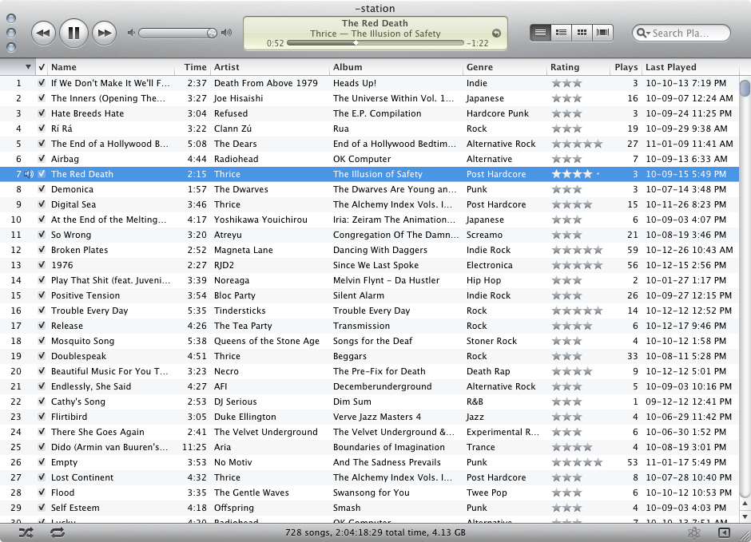

How it works
Input – data collection of the songs
Output – next song to play, based on current playlist
4

Slide 4
How it works
Computes similarity between song to the current playlist
Parameters taken into account – BPM, Genre, Key, Artist
Total score calculation is based on weights
Returns the song with the highest score (=highest similarity to the current playlist)
4

Slide 5
Testing & Results
Test data – a playlist that was manually created
4

Slide 6
Main Difficulties
Very large music collection – contains songs which barley played normally
Testing the algorithm
Songs with missing details
4

Slide 7
Future tasks
Recommendation based on user inputs (favourite artists, newest songs etc…)
Taking into account release date of songs
Limit the number of recommendations from the same artists
Calculate weights differenlty
4

Slide 8
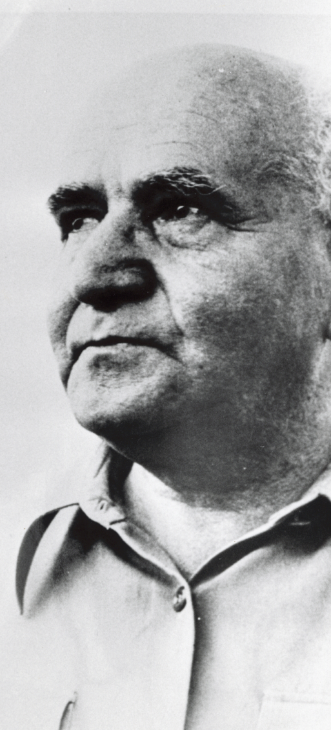
Thank You!
13

